Slide 1
Annual Title I Family Meeting August 13th &15th 5:00-6:30 p.m. Pete Johnson, Principal Mattie D. Smith, Assistant Principal Rica M. Davis, PLC Coach
Notes:
Welcome to Grahamwood. We are glad you are here.

Slide 2
Agenda
Welcome
Title 1 Information
District/School Updates
Closing Remarks/Dismissal
Notes:
Here is our agenda. I am Rica Davis the PLC Coach. I am responsible for Title 1 and assisting teachers in helping our students. Ms. Fuller is our Instructional Faciliator- she is resposnble for assisting teachers in your helping our students as well. Ms. Rachel Helton Johnson – she is our optional school coordinator. She is all things optional school related. Next is Ms. Hudson and Ms. George she is our schools professional counselor she is responsible for providing social and emotional well being for teachers, students, and anyone who needs assistance. Mrs. Smith is our assistant principal she is Mr. Johnson's right hand woman. Mr, Johnsnon is all things Grahamwood. He might be directring traffic one day and the next day feeding students.

Slide 3
Grahamwood Vision Grahamwood Mission
Grahamwood Elementary School is an exemplary student-centered educational community with an exceptional team of stakeholders who create a nurturing environment where all students achieve academic excellence, exhibit good character, and where hopes and dreams are encouraged.
The mission of Grahamwood Elementary School is to prepare our students to become productive citizens by providing a positive, safe, diverse, and academically challenging environment that develops the cultural, social, and physical skills of our students.
Notes:
This is our mission and vision. This is our guide to educating our students. We strive to create an enviroment where all students achieve, exhibit good charaacter, and where we encourage our students to dream big. We will do that by providing a positive and academically challenging enviroment.

Slide 4
Grahamwood is a Title I School.
Being a Title I school means that Grahamwood receives federal funding (Title I Dollars) to supplement the school’s existing programs. These funds can be used to:
Identify students experiencing academic difficulties and providing timely assistance to help these students meet the State’s challenging content standards.
Purchase supplemental staff/programs/materials/supplies
Conduct parental involvement meetings/activities
Recruit/Hire/Retain Highly Qualified Teachers
Notes:
We are Title 1 school. This is not a bad thing. We receive federal funding to supplement academics. The funding might be used to purchase additional supplies to help with academics and conduct parent involvement.

Slide 5
Family Engagement Plan - MSCS Policy 5010
The school and home have a shared goal
of promoting success in our children.
Our parents will act as advisors, resource persons and coordinators in the following ways:
Attend and participate in school events
Serve with the Parent Teacher Organization
Become school supporters and advocates
Respond to memos, surveys, and questionnaires
Notes:
We have shared goal in promoting success of our children. We want you to attend all activities, serve on GPTO, respond to memos.

Slide 6
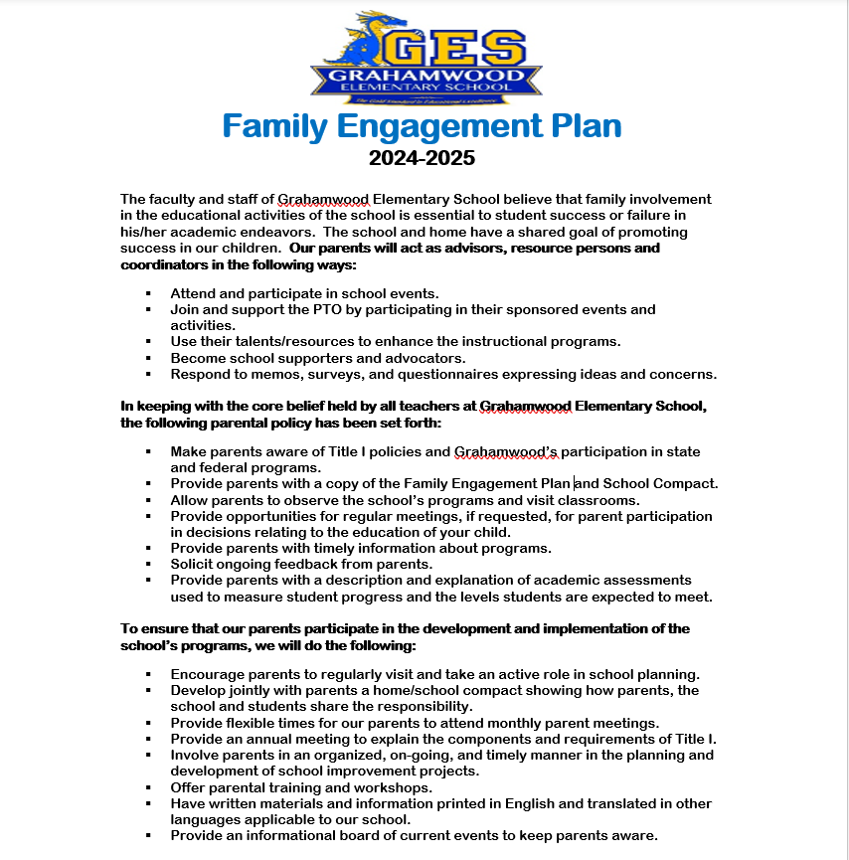
Grahamwood’s Family Engagement Plan
Notes:
You should have received our plan when you signed in. We want you your expertise to help Grahamwood a better place by using your resources to enhance our instructional program. We will offer parental training and workshops. We will communicate through class dojo and facebook. So please make sure you sign up for Grahamwood's dojo.

Slide 7
Reporting Pupil Progress
Families have access to track pupil progress.
Student Agenda Books
Weekly Folder-Teacher will select the day
Progress Reports every 4 ½ weeks
Report Cards every 9 weeks
Testing Data
Class Dojo
Notes:
You can track progress through student agenda books(not all teachers use these) Weekly folders, Progress reports and report cards that information will be available in Powerschool. Students take I-ready test three times a year and you can receive information about your child's results. Your child's teacher will go more in depth during meet the teacher night.

Slide 8
Parent-Teacher Conferences
Parent-teacher conferences are an integral part of maintaining communication between home and school.
There are two district-wide conferences in September and February; however, if you need to have a conference with your child’s teacher, please call the school office or email the teacher to set up an appointment before or after the school day.
September 5, 2024 4-7 p.m.
February 13, 2025 4-7 p.m.
Notes:
The district offers two conferences a school year. However if you need a conference before or after these dates please make an appointment with your child's teacher.

Slide 9
Parental/Family Involvement Policy
The purpose of this policy is to establish expectations for parental involvement and comply with all pertinent mandates of state and federal regulatory standards which require that all parents have access to various levels and types of parental involvement activities.

Slide 10
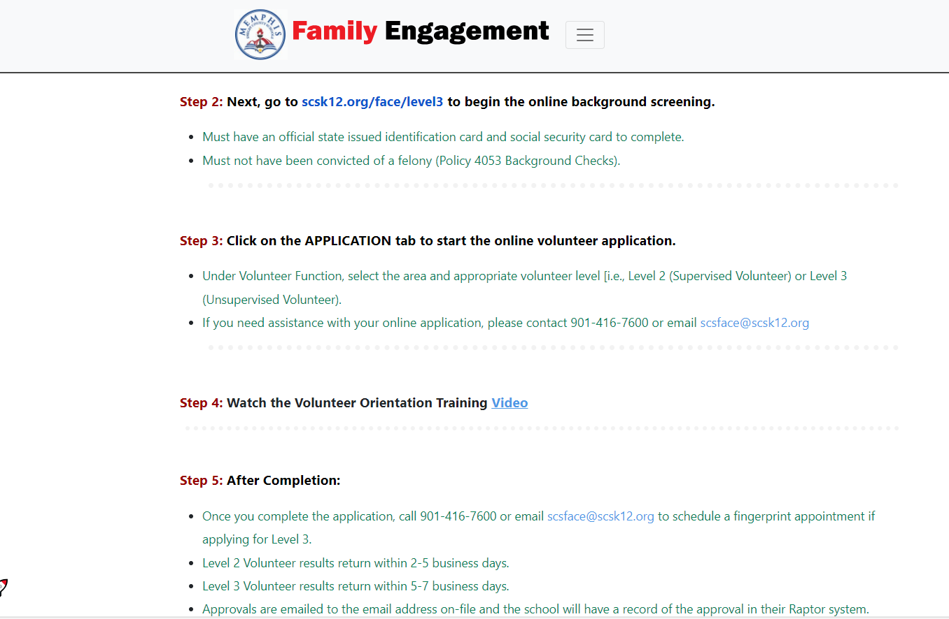
Parental/Family Involvement Policy

Slide 11
Family Involvement Activities
Including, but not limited to:
Grahamwood Parent Association
Volunteer in the Classroom
Annual Title I Night
Meet the Teacher Night
Family Literacy Night
Family Math Night
Family Science/STEM Night
Family Data Night
Tutoring
Music & Art
Events
Field
Days
Promotion Ceremonies

Slide 12
Parent Training
Grahamwood Guidance Department provides the following training:
Raising Emotionally Intelligent Children
ADHD/Autism Awareness
Confidence and Belief
Test Taking Tips

Slide 13
Student Code of Conduct/Grahamwood’s Discipline Policy
RTI-B Manual
is on the website.
This is the
current MSCS
Handbook.

Slide 14
School Improvement Plan
All Tennessee schools are required to have an annual School Improvement Plan which indicates a comprehensive needs assessment for the entire school.
-----------------------------------------------------------------------------------------------------------------------------------------------------------------------------------------------------------------------------------------
Each plan must:
Indicate its specific goals for improvement
Identify areas of strengths and growth
Give a breakdown of how funds will be used to address these areas
Parents have the right to view the school’s plan upon request AND the plan is available on Grahamwood's website.
Notes:
The school Improvement plan is our map on how we our going to meet our school wide goals.

Slide 15
School Improvement Plan
Grahamwood's Goals
ELA: increase proficiency rates from 46.1 % to 50.1 %.
Math: Increase proficiency rates from 45.5% to 49%.
Attendance: Increase attendance rate from 93% to 98%.
Notes:
These are our current goals.

Slide 16
Parent's Right to Know
Teacher's Qualifications
Non-instructional Staff Member's Qualifications
Your child's achievement level
Notes:
Title 1 requires that you will know the following information.

Slide 17
Home/School Compact
This compact is jointly developed by parents and school staff.
This compact outlines how parents, the entire school staff, and students will share the responsibility for improving student academic achievement.
The school’s compact is available on Grahamwood's website.
Notes:
Our School Home compact is an agreeement that each participating person will adhere to. Students will take home all written notices, complete and return homework, read daily.
Parents will make sure your child is punctual, make sure they are in the proper uniform, encourage your child to do their best, communicate with teacher. Teachers agree to provide consistent communication with parents, provide quality teaching to students. The school agrees to develop partnerships with parents to proivde an environment of learning. We will encourage respect among the students, facultys and parents.

Slide 18
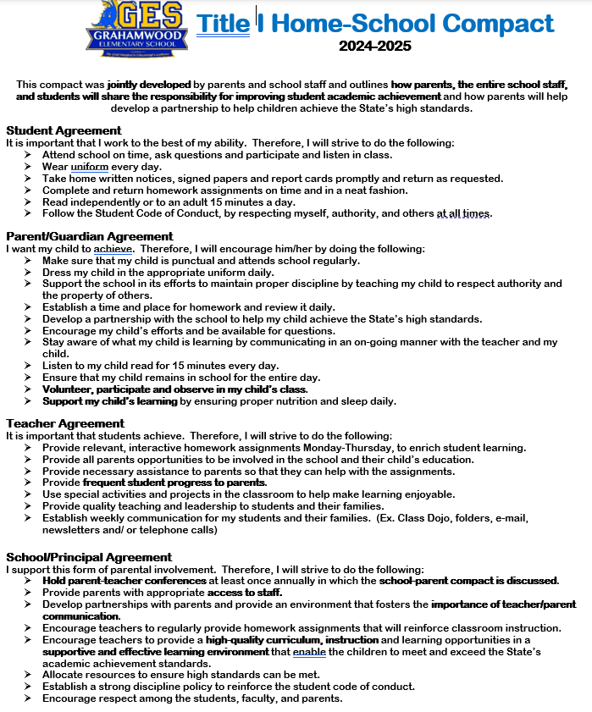
Grahamwood's Home/School Compact

Slide 19
Notes:
Mr. Johnson will now give you quick school updates. Followed by Mrs. Smith who will dismiss everyone to the right places.

