Slide 1
Enzymes
Biological Catalysts!

Slide 2
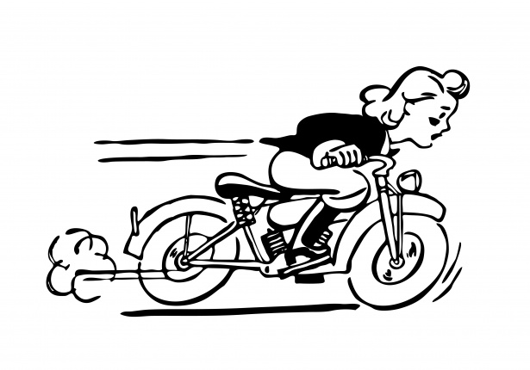
What is a catalyst?
A catalyst is a substance that speeds up the rate of a chemical reaction, without entering the reaction itself
Catalysts can be:
Inorganic (heat)
Organic (enzymes)
Most catalysts are organic!
Amoeba Sisters: Enzymes

Slide 3
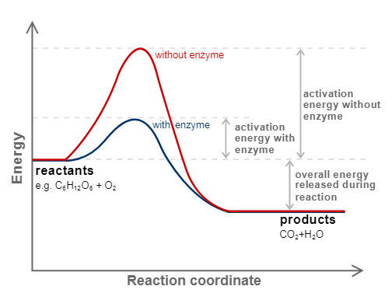
Enzyme Facts!
An enzyme is an organic catalyst made of protein
Most enzymes end in –ase
Enzymes work by lowering the activation energy of a chemical reaction. This means it lowers the amount of energy needed to start the reaction, so the reaction happens faster!

Slide 4
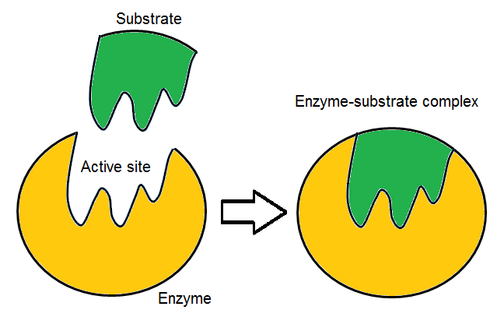
How Enzymes WOrk
Enzymes act on molecules called substrates
They bind to their substrates at the active site
Typically enzymes are larger than their substrates
Enzymes fit into their substrates like a key fits into a lock: it is very specific!
This is called the “lock and key model” of enzyme action

Slide 5
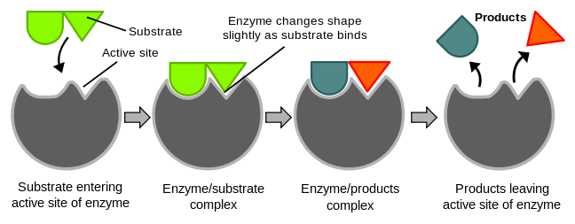
Steps of enzyme action
Enzyme joins with its substrate
Enzyme and substrate form an enzyme-substrate complex
Enzyme action takes place
Enzyme and products separate. The enzyme is unchanged and can be reused!

Slide 6
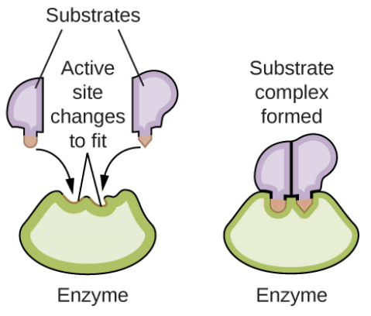
Induced Fit Model
Enzyme is not rigid and changes shape slightly when the substrate enters
Still specific to one substrate!

Slide 7
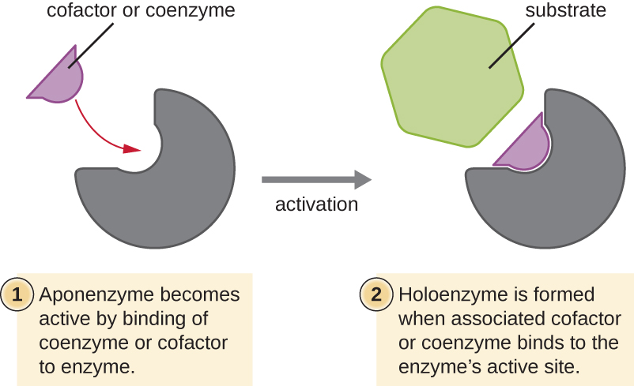
Coenzymes and cofactors
Enzyme helpers!
Bind to enzyme and help it to better fit with its substrate
Coenzymes: Organic (vitamins)
Cofactors: Inorganic (metal ions like iron)

Slide 8
Factors Affecting Enzyme Action
Enzymes are picky! They only work under specific conditions
Factors which affect enzyme action include
pH
Temperature
Concentration of enzymes and substrates

Slide 9
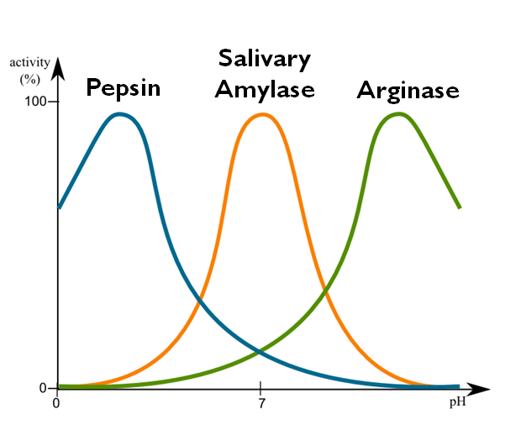
pH and Enzyme Action
Each enzyme has a specific pH in which it will work
Different enzymes work at different pH levels.
Pepsin, an enzyme in your stomach, works best at a pH of 2. Why?
Amylase, an enzyme found in your mouth, works best at a pH of 6.8. Why?

Slide 10
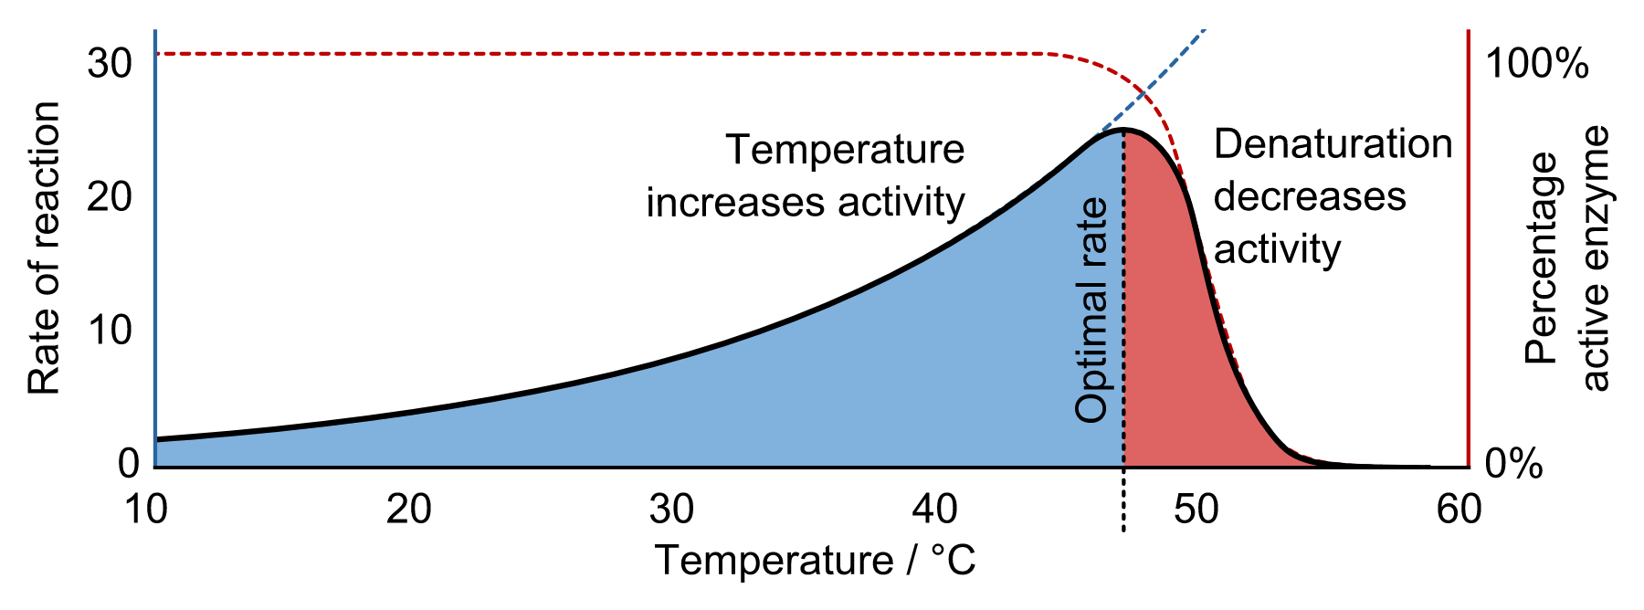
Temperature and Enzyme Action
All enzymes have an optimal temperature at which they work the most effectively
Optimal temperature for humans is 37°C
Optimal temperature for dogs is 101-102°F

Slide 11
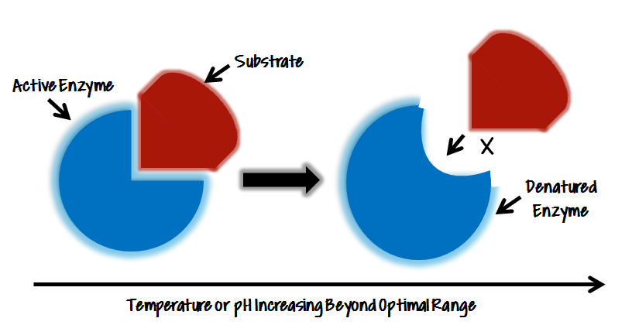
What happens if temperatures get too high?
Enzymes change shape (kind of like melting!)
When this happens, we say the enzyme is denatured

Slide 12
What happens if temperatures get too high?
If the enzyme is not shaped correctly, it cannot bind with its substrate and can no longer do its job
Changes in pH can denature enzymes too!

Slide 13
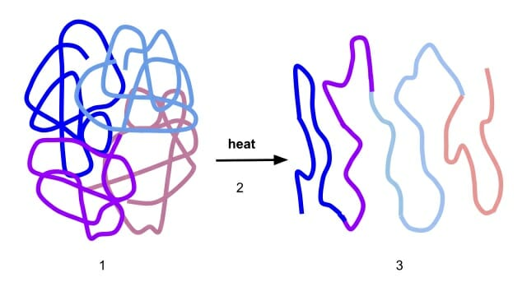
Denatured protein

Slide 14
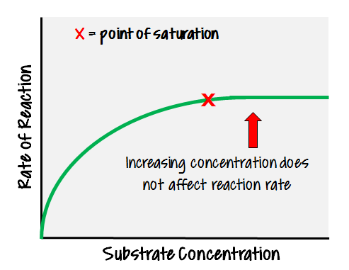
Concentration and Enzymes
As concentration of both the enzyme and the substrate increases, the rate of enzyme action increases to a certain point, and then will level off

Slide 15
Why does this leveling off occur?
If the concentration of the enzyme increases, reaction rate will initially increase. However, as all of the substrate is broken down, the excess enzyme has nothing to combine with, so reaction rate levels off.
If the concentration of the substrate increases, reaction rate will initially increase. However, if there are not enough enzymes to act on the increasing substrate, the reaction rate will level off.

Slide 16
Summary Questions:
What type of biological molecule is an enzyme considered?
Why is enzyme action similar to the action of a key fitting into a lock?
What is the difference between a substrate and an active site?
Why are changes in pH and temperature critical to the proper functioning of an enzyme?

Slide 17
Answers:
An enzyme is a protein.
An enzyme is specific. It only acts on one type of substrate. This is just like how only one lock can only be opened by one key!
The active site is the portion of the enzyme where it binds to the substrate. A substrate refers to the molecule in which the enzyme acts.
If both the pH and temperature fall out of the optimal range, it can cause an enzyme to denature, or change shape. This causes it to no longer fit with its substrate, and as a result it cannot do its job.

