Slide 1
WINCHESTER ELEMENTARY sCHOOL
McKinney-Vento Homeless Assistance Act
Presented
November 5th, 2024
LOIS CRUMP, PLC COACH

Slide 2
Agenda
Introductions
McKinney-Vento Definition and Rights
District's Homeless Liaison Role and Responsibility
Unaccompanied Youth
Enrollment
Dispute Process

Slide 3
McKinney-Vento Homeless Education Act
Under McKinney-Vento, state educational agencies (SEAs) and local educational agencies (LEAs) must ensure that homeless children and youths have equal access to the same free, appropriate public education, including a public preschool education, as provided to other children and youths. ​

Slide 4
The McKinney-Vento Definition of Homeless
Individuals who lack a fixed, regular,& adequate nighttime residence:
Fixed: not subject to change, permanent, stationary
Regular: consistent, routine, predictable, normal, standard
Adequate: sufficient to meet physical & psychological needs
Can the student go to the same place (fixed) every night (regular) to sleep in a safe & sufficient space (adequate)?

Slide 5
Defining Homelessness
Students are considered homeless when they are:
Sharing the housing (Doubled-up) of others due to loss of housing, economic hardship, or similar reason;
Living in motels, hotels, trailer parks or camp grounds due to the lack of alternative accommodations;
Living in emergency or transitional shelters;
Abandoned in hospitals
Fleeing from domestic violence

Slide 6
Defining Homelessness
Staying at a primary nighttime residence that is a public or private place not designed for or ordinarily used as a regular sleeping accommodation for human beings;
Living in cars, parks, public spaces, abandoned buildings, sub-standard housing, bus or train stations, or similar settings;
Migrants living in the conditions described above.

Slide 7
Defining Homeless Unaccompanied youth
An unaccompanied youth is defined in the McKinney-Vento Act as “a homeless child or youth not in the physical custody of a parent or guardian.” (42 U.S.C. § 11434a(6)). This definition can be used to describe youth who are residing with a caregiver who is not a parent or guardian as well as youth who are living without the care of an adult.
An unaccompanied youth is a child or youth who is not in the physical custody of a parent or guardian and lacks a fixed, regular, and adequate nighttime residence.
An unaccompanied youth must fit the definitions of both homeless and unaccompanied in the McKinney-Vento Act to receive assistance under the provisions in the law.

Slide 8
Defining Homeless Unaccompanied Youth (Continued)
Unaccompanied youth are eligible for services under the McKinney-Vento Act regardless of the circumstances that led to their separation from family; this includes youth who ran away from home, and youth who were forced from the home by their families.

Slide 10
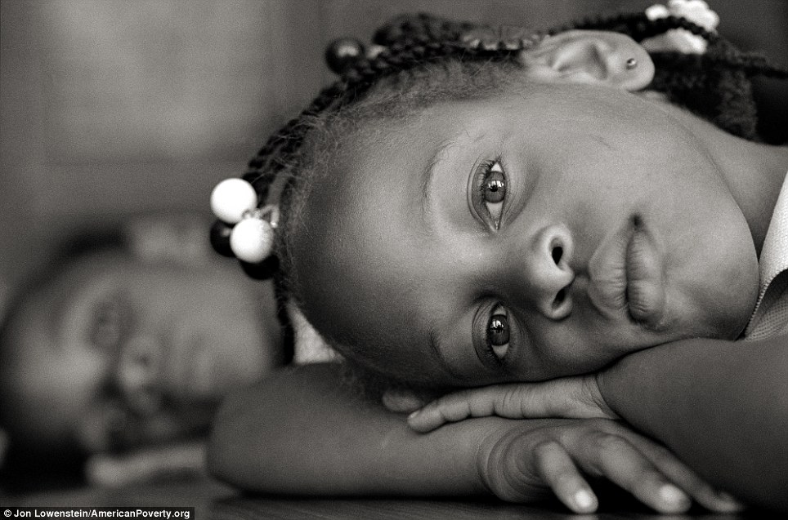
Causes of homeless
Housing Shortage
Job Loss
Illness
Increasing Cost of Living
Natural Disasters
Incarcerated Guardians
Domestic Violence

Slide 11
Enroll now, ask later
Means “attending classes & participating fully in school activities”
Must be immediate
Even if students lack school, medical, or other records normally required.
Even if enrollment or application deadlines were missed while homeless.
Even if the student has history of absences or outstanding fines/fees.

Slide 12
LEA Preschool Enrollment
Immediate enrollment applies to preschools, as long as there is space.
McKinney-Vento children should be prioritized on waiting list.
Homeless children are also automatically eligible to attend preschool programs funded under Title I. (ESEA section 1115(c)(2)(E)).
State McKinney-Vento plans must describe procedures that ensure that homeless children have access to public preschool programs administered by the SEA or LEAs.

Slide 13
School Selection
Students experiencing homelessness may attend either:
The local attendance area school:
Any public school that students living in the same attendance area are eligible to attend;
The school of origin:
The school the child or youth attended when permanently housed; or
The school in which the child or youth was last enrolled, including preschool.
When considering matters of best interest, keep homeless students in their schools of origin, to the extent feasible, unless this is against the parent’s or guardian’s wishes.
The placement determination should be a student-centered or individualized.

Slide 14
identification and enrollment process
Identify the student.
Enroll the student in school.
Enter the student in PowerSchool.
Contact Federal Programs’ regarding the identification of the student.
In case of eligibility dispute, refer the case to S.E.E.D and inform Federal Programs.

Slide 15
Dispute Resolution
If, after conducting the best interest determination, the district determines that it is not in the child’s or youth’s best interest to attend the school of origin or the school requested by the parent, guardian, or unaccompanied youth, the school must provide the parent, guardian, or unaccompanied youth with a written explanation (questionnaire) of the reasons for its determination, in a manner and form understandable to the parent, guardian, or unaccompanied youth, including information regarding the right to appeal.
The child or youth shall be immediately enrolled in the school in which enrollment is sought, pending final resolution of the dispute, including all available appeals
Pub. L. No. 114-95, § 9102(5), 129 Stat. 2130
Students must receive all services for which they are eligible until final resolution of all disputes and appeals.
EHCY Non-Regulatory Guidance, Question K-7

Slide 16
DISPUTE resolution (CONTINUED)
Enrollment disputes are mediated in accordance with law.
If a dispute arises over school selection or placement, the District must admit a displaced child or youth to the school in which enrollment is sought by the parent, pending resolution of the dispute.
The District shall provide a written explanation (a copy of the signed questionnaire), provide information regarding the right to appeal, to the homeless student’s parent/ legal guardian/custodian, or to the homeless student if unaccompanied.
If the parent/legal guardian/custodian or unaccompanied youth continues to disagree with the District’s final decision, he/she may contact the State McKinney-Vento Coordinator.

Slide 17
Support provided by District Homeless staff
Every school district must designate an appropriate staff person to serve as the local homeless education liaison.
Identify displaced children/youth and provide needed services.
Ensure the displaced students can enroll immediately and participate fully in school.
Inform parents, guardians, and youth of educational rights.
Ensure disputes are resolved promptly.
Support unaccompanied homeless youth in school selection regarding dispute resolution.
Collaborate with other District programs and community agencies. Link displaced students with other services, as needed.

Slide 18
Homeless affidavit & referral form
Please note: the Homeless Questionnaire and the Shared Affidavit are two different documents.

Slide 19
Services Provided by Shelby County Schools
Immediately Enrollment
Uniform Vouchers
School Supplies
Health Services
Tutoring
Bus Passes
Housing Referrals

Slide 20
Effective Practices
Collaborate with school supports.
Refer the student for academic services (such as tutoring, intervention, etc.).
Suggest participation in extra-curricular activities.
Collaborate and communicate with families.
Work with other departments in the School District.
Transportation, SPED, Parent Resource Center, Family Engagement, Coordinated School Health.

Slide 21
Required homeless posters
English
Spanish

Slide 22
CLOSING
Working together, we can strive to ensure all children have access to the support they need for achieving academic success so that no child experiencing homelessness is left behind.

Slide 23
Shelby County Schools
Staff Contact Information
Manager of Grants & Special Populations
Theresa Utley- utleytb@scsk12.org
(901) 416-4250
Federal Program Liaison
Clarence Bayes- bayesc@scsk12.org
(901) 416-4189
Federal Program Specialist
Shericka Blair- blairSLl@scsk12.org
(901) 416-4204
Federal Programs, Grants, and Compliance
3782 Jackson Avenue
Memphis, Tennessee 38108
(901) 416-4250 Direct
(901) 416-4243 Fax

Slide 24
Work cited
National Center for Homeless Education: https://nche.ed.gov/about.php
National Association for the Education of Homeless Children and Youth: http://naehcy.org/
Helpline: 800-308-2145 or homeless@serve.org

Slide 25
QUESTIONS ?

