Slide 1
FCES Annual Title 1 Meeting August 22, 2024 @ 1:30-2:00 p.m. August 23, 2024 @ 7:30-8:00 a.m.
Dr. DeAngela Graham, Principal
Dr. D’Kendrick Williams, Assistant Principal
Hunter Bethea, PLC Coach
Brittany Williams, Professional School Counselor

Slide 2
Dr. DeAngela Graham Principal

Slide 3
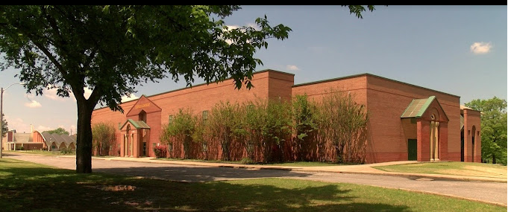
About Us
School Hours
8:00 a.m.-3:00 p.m.
Breakfast starts at 8:00 a.m. in the classroom
1602 Dellwood Ave
Memphis, TN 38127
Phone: 901-416-3804

Slide 4
Frayser-Corning Elementary Mission and Vision Statements
Mission
Frayser-Corning Elementary School's staff, parents, and community are dedicated to the intellectual, personal, social, and physical growth of students. Our team recognizes the value of professional development in order to rigorously challenge students. Our teaching practices are both reflective and responsive to the needs of our scholars. Through diversified experiences, our scholars discover their potential, achieve readiness for college and careers, and are soaring to excellence.
Vision
FCES is committed to ensuring a stronger, more productive and reimagined Frayser-Corning community. We commit to ensuring strong instruction that deeply engages ALL students, to maximize learning outcomes. We also commit to fostering a culture instilled with high expectations for ALL stakeholders through supporting social, emotional, and academic excellence for ALL.

Slide 6
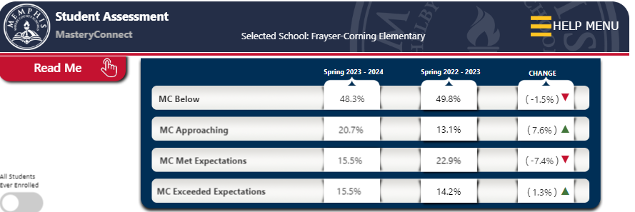

Slide 7
How will we address our deficits?
RTI2
Small Group Instruction
During School Tutoring (4th and 5th Grade)
After School Tutoring (Starts September 9 )
ZAP Fridays (Zeros are not permitted!)
IXL
Blended Learning

Slide 8
Annual Title 1 Overview Hunter Bethea, PLC Coach

Slide 9
District/School Progress/AYP
Under new federal measures for accountability, each school is responsible for a portion of the school district’s AYP AMOs. Frayser-Corning is designated as a Priority school for the 2023-2024 school year by the state of Tennessee. Our school district is a level 5 and continues to make gains and so will FCES.
School Improvement Plan
Frayser-Corning Elementary School maintains a current School Improvement Plan which is updated annually to reflect current data and changing student needs. We solicit your support in bringing ideas for increasing student achievement. A copy of the plan will be made available upon your request in October.

Slide 10
Annual Title 1 Overview Hunter Bethea, PLC Coach
Additional Parent Meetings
Annual Title I Parent Meetings
Parent Trainings (TBA)
Curriculum Night(s)
Parents’ Right to Know
All parents have the right to request the following:
A teacher’s professional qualifications, licensure, grade(s) certification, waivers
A teacher’s baccalaureate and/or graduate degree, fields of endorsement, previous teaching experience
A paraprofessional’s qualifications
An annual notice of Student Education Records Privacy and notice for disclosure of School Directory Information
An assurance that their child’s name, address and telephone listing not be released to military recruiters
All parents should receive the following:
Their child’s level of achievement on each of the state’s academic assessments
Notification of right to transfer their child to another school in the district if the student becomes the victim of a violent crime or is assigned to an unsafe school
District Family Involvement Policy and School Parent Involvement Policy
Their right to public school choice, Supplemental Educational Services and more effective involvement if their child’s school is identified for school improvement

Slide 11
Annual Title 1 Overview Hunter Bethea, PLC Coach
Teacher Qualifications
All teachers hold a state-issued teaching certificate or permit.
Title I School Status
Frayser-Corning Elementary operates a School-wide Title I program.
School/Parent Compact
Federal law requires us to distribute our School/Parent Compact to parents to ensure their involvement in their children’s educational process. This document is located on the school’s website and was distributed in our Tuesday Folders on August 20, 2024.
Family Engagement
SCS Policy 7009
Federal law

Slide 12
Annual Title 1 Overview Hunter Bethea, PLC Coach
Family Engagement
SCS Policy 7009
Federal law requires us to distribute our Family Engagement Plan to parents to ensure their involvement in their children’s educational process. This document was in your child’s Tuesday folder, August 30, 2024. It will also be located on the school’s website.
Reporting of Pupil Progress
Pupil progress is reported through Progress Reports and Report Cards, IXL reports, I-Ready Diagnostic reports, and AimsWeb reports for intervention, and classroom teacher contact (via phone, print, or email).

Slide 13
Annual Title 1 Overview Hunter Bethea, PLC Coach
Parent-Teacher Conferences
District-wide Parent-Teacher Conferences are held twice a year (one per semester). Additionally, parents may request a parent-teacher conference by appointment at any time throughout the school year. Our next Parent Conference was
Thursday, September 5, 2024, from 4:00 p.m. until 7:00 p.m
Parental Involvement Requirements
Please see Family Engagement and School/Parent Compact.

Slide 14
Annual Title 1 Overview Hunter Bethea, PLC Coach
Annual Title 1 Overview Hunter Bethea, PLC Coach
Parent Training
Family and Community Engagement (FACE)
COE Building, Room 164 160 South Hollywood, Memphis, TN 38112 901-416-7600
FACE offers a variety of parent trainings and assemblies.
To receive a calendar of these events, please call the FACE Office .
SCS Parent Welcome Center
2687 Avery Ave.
Memphis, TN 38112
901-416-5300

Slide 15
Student Code of Conduct
Student Code of Conduct
The MSCS Student Code of conduct is available, on the Memphis Shelby County Schools’ website – www.scsk12.org – under the Students & Parents tab.
FCES Student Code of Conduct

Slide 16
The FCES School Counseling Services Department provides support to all FCES scholars through the implementation of a comprehensive, standards-based counseling program that fosters the academic, social-emotional, and college and career development, while partnering with parents, guardians, educators, and the community, to ensure that today’s students become the productive, well-adjusted citizens of tomorrow. Individual, small group, and classroom guidance counseling sessions aid and assist in the following areas:
☑ time management
☑ anxiety, stress, or anger management & coping strategies
☑ test-taking tips, tools, & strategies
☑ forming & maintaining healthy relationships
☑ problem-solving skills
☑ self-esteem building
☑ college/career exploration
☑ and more!
Notes:
Dr. Williams Tutoring info

Slide 17
The Importance of School Attendance
z

Slide 18
Students are marked tardy/late starting at 8:30 am daily.
Early dismissal ends at 2:30 pm daily.
Regular dismissal begins promptly at 2:45 pm starting with walkers followed by dismissal of our car riders at 2:50 pm.
A note must be provided for all student absences and must include the student's full name as well as the date and reason for the absence. Notes can be handwritten and given to the main office or emailed to the FCES Attendance Specialist, Mr. Tyler Watson at watsontj1@scsk12.org.

Slide 19
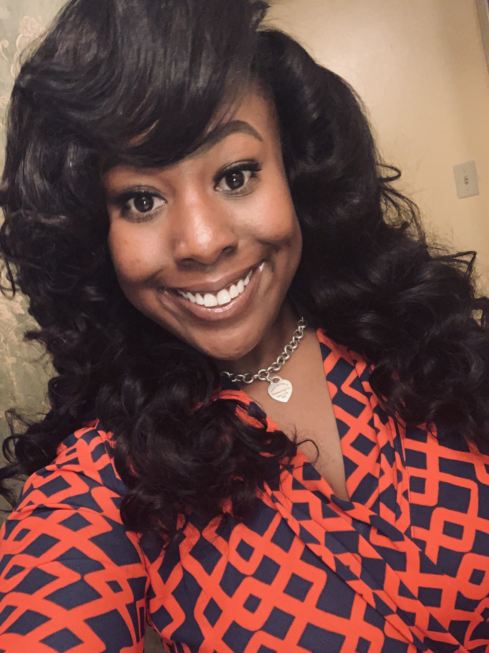
Brittany N. Williams, M.Ed.
Professional School Counselor
Via Email: hillb4@scsk12.org
Via Phone: 901-416-4828
Notes:
Dr. Williams Info

Slide 20
Response to Intervention and Instruction (RTI2)
What is RTI2? How Can It Help Improve Literacy and Mathematics?
Response to Instruction and Intervention (RTI2) is a general education program to support student academic growth by allowing them to receive additional, specialized instruction in specific areas of reading, writing and math needing improvement.

Slide 21
Key Components of RTI2
◻ High quality curriculum and instruction in your child’s general education classroom (Tier I)
◻ Universal Screening to determine performance and progress that will identify who needs help.
◻ Intervention to match your child’s area of need in reading, writing and mathematics. (Tier II and Tier III)
◻ Progress Monitoring to determine your child’s success.
◻ Parents receive monthly reports on their child’s progress monitoring results, goals and best practices to help at home.
◻ To support your child, there is a district and school level RTI2 Team available to answer questions, just contact the main office if you need to speak with someone.
Notes:
RTI info…

Slide 22
Dr. D. Williams, Tutoring Coordinator
Email: williamsdt2@scsk12.org
Grade 4 and 5 are priority grades
1:8 Tutor to Students ratio

Slide 23
Regularly check the MSCS website for updates.
http://www.scsk12.org/

Slide 24
Thank you for attending!

