Slide 1
Annual Title I Parent Meeting
Mr. Craig Mckee, Principal
Mrs. Rhonda B. Wilson, Professional Learning Coach
Thursday, August 22, 2024 3:30-4:30pm
Friday, August, 23,2024 8:30-9:30am

Slide 2
Mscs parent and Family Engagement Policy
Memphis Shelby County Schools aims to promote positive partnerships between parents and the district to support high standards and improve student academic achievement.
This policy applies to parents with students enrolled in Shelby County Schools, parent organizations, and District employees.

Slide 3
Parent and family Engagement Requirements
Recognizing that parents are the key stakeholders in the education of their children, the district seeks to establish effective family-school partnerships that build the capacity of parents to improve student achievement and promote academic success. Such activities, in accordance with the Elementary & Secondary Education Act (ESEA) requirements, shall at a minimum provide an environment where parents (1) play an integral role in assisting with their child's learning; (2) are encouraged to be actively involved in their child's education at school; (3) are full partners in their child's education and are included, as appropriate, in decision-making and on advisory committees to assist in the education of their child(ren); and (4) are involved in other activities as deemed appropriate.

Slide 4
What is Title I?
“Title 1” is the federal program that provides funding to local school districts to improve the academic achievement of disadvantaged students. It is part of the Elementary and Secondary Education Act first passed in 1965.

Slide 5
Title I School Status
Bethel Elementary is a Title I school.
Additional funds are provided to our school and determined by:
Student enrollment
Students needs
The number of students from low socio-economic backgrounds

Slide 6
School Status 22-23
Bethel Grove is classified as a Superintendent School because of its letter grade of "D" from the state of Tennessee. This letter grade is based solely on the TCAP test scores.
Bethel Grove showed gains in 23-24 and as soon as the updated data are released the school will notify parents of the school letter grade.

Slide 7
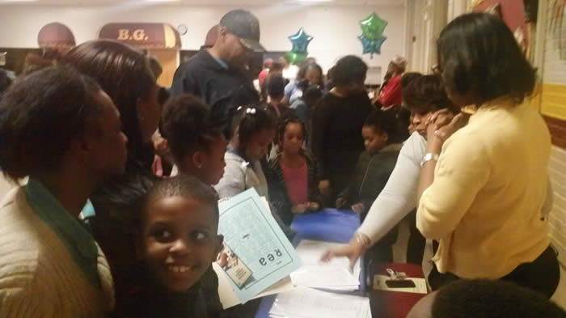
Who benefits from Title I?
All students and parents through instructional materials, tutoring, teachers, coaches, equipment, and other resources.

Slide 8
Family Engagement Plan
The family engagement plan is an agreement between our school, Title I, and parents to ensure that all parents are involved in their child’s education.

Slide 9
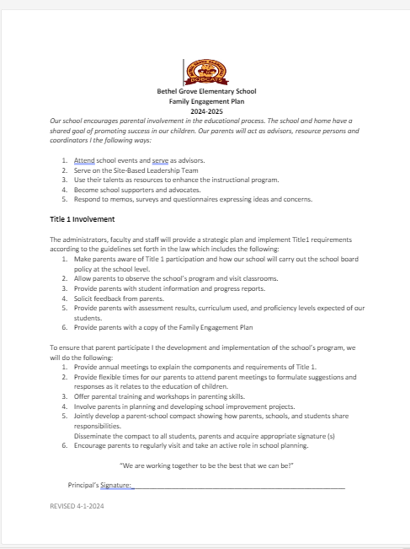
Family Engagement Plan

Slide 10
School-Parent Compact
A promise that parents, teachers, and the principal will work together to ensure that students learn and have a productive school year.

Slide 11
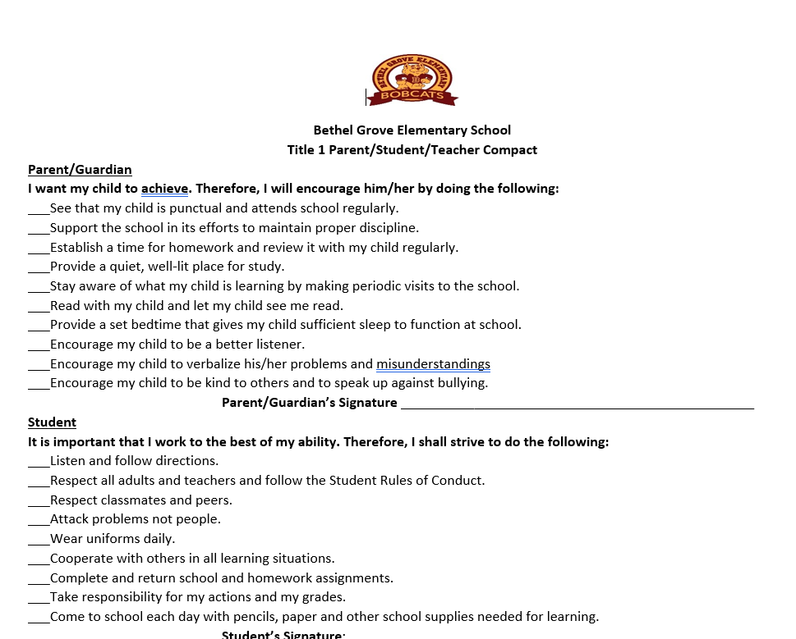
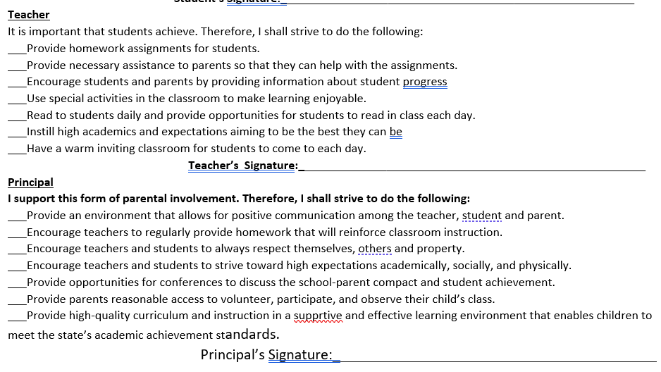
Parent Compact
This Photo by Unknown Author is licensed under CC BY-SA

Slide 12
Reporting Student Progress
Weekly/Bi-Weekly Communications with parents (via email, text, phone calls, Wednesday Folders)
Wednesday folders (every week) Progress reports (every 4 ½ weeks)
Reports Cards (every 9 weeks)
Teacher-Parent Conferences as scheduled

Slide 13
Parent-Teacher Conferences
A conference can be scheduled with a teacher anytime a parent feels the need to discuss their child’s academic progress.
District-wide conferences:
September 5 , 2024- We look forward
to seeing you there!
February 13, 2025
Notices will be sent home prior to the conferences to schedule appointment times.

Slide 14
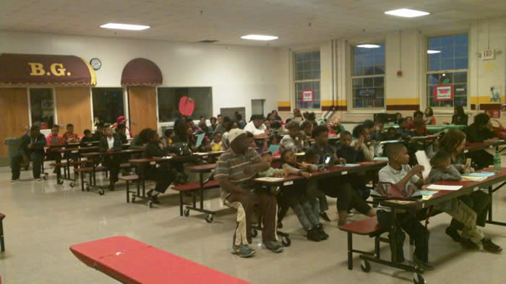
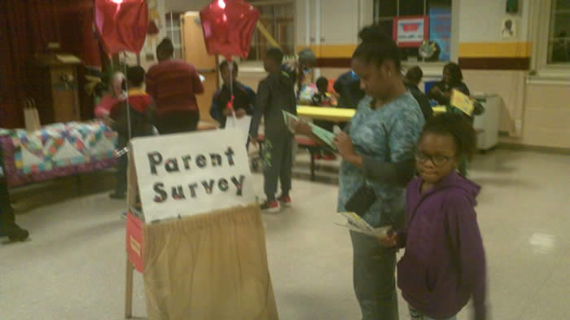
Parental Involvement
We LOVE parental involvement at Bethel Grove because parents are a vital part of this school and their children’s education. Some of the ways you can be a part is through our Facebook page, School Website, Class Dojo, etc..
Parental Involvement Opportunities
Volunteering Before and After School-
helping to keep students safe
Field Trips
Family Literacy Night
Family Math Night
Learning on the Lawn
Reading and Math Comprehension Parent Seminar
Doughnuts for Dads
Muffins for Moms
Family Science Night
Family Engagement Meetings

Slide 15
Parent Training
Bethel Grove provides opportunities for parents to come and learn strategies that they can use at home to support student learning.
The first parent seminar for 2024-2025 will be held in October.
Reading Parent Seminar
In this seminar, teachers will share easy yet effective strategies that can be used at home to coincide with what students learn at school.

Slide 16
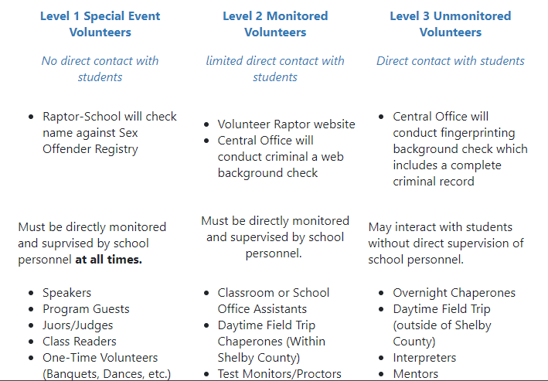
Steps to becoming a volunteer during the school Day

Slide 17
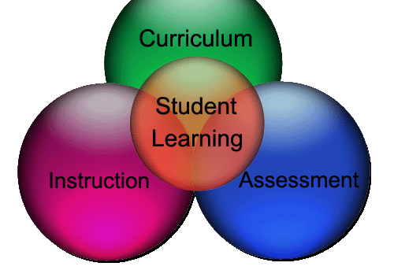
School Improvement Plan
The School Improvement Plan or the SIP plan is our school's action plan for school wide improvement. It is a working document that is developed by a team that includes school leaders, teachers, parents, and community stakeholders.
Teachers, parents, and students work collaboratively in committees to develop the plan.

Slide 18
Parents’ Right to Know
All parents have the right to request:
A teacher’s professional qualifications, which includes: state qualifications, licensure, certification, waivers
A teacher’s bachelors and/or graduate degree, fields of endorsement, previous teaching experience
A paraprofessional’s qualifications
An assurance that their child’s name, address, and telephone listing not be released to military recruiters
To find this information you may visit: https://tdoe.tncompass.org/public/search

Slide 19
Student Code of Conduct
A list of infractions of school discipline, identified by district, that teachers, administrators, and district officials utilize to outline offenses and penalties by category.

Slide 21
Contact Us School phone- 416-5012
Craig McKee, Principal mckeec@scsk12.org
Mrs. Rhonda B. Wilson, Professional Learning Coach
wilsonrb@scsk12.org
Mrs. Torquoise Mallory, Dean of Students, harristd@scsk12.org
Ms. Tamara Dickerson, Professional Counselor, dickersont1@scsk12.org

