Slide 1
Cromwell Elementary School
Annual Title I AM/PM Meeting
September 27 & 30, 2024
Mrs. JoAnn McMillian, Principal
Mrs. Brenda Ingram, Assistant Principal
Ms. Kawana VanBuren, Professional School Counselor

Slide 2
Cromwell parents

Slide 3
Instructional Expectations
RTI2 | Response to Instruction and Intervention 45 minutes each day: Computer based and Face to Face Every child
Reading | Wonders Curriculum 75-120 minutes daily Foundational Skills, Reading, Writing, Grammar, Spelling Whole Group, Small Group, and Workstations GRR (Gradual Release of Responsibility: I Do, We Do, You Do in Pairs, You Do Alone)
Math | enVision Math 60 minutes daily Whole Group and Small Group 5Es (Engage, Explore, Explain, Elaborate, Evaluate)
Science | Inspire Science 40-60 minutes 2-3 days a week (K-2) Daily (3-5) 5Es
Social Studies | Studies Weekly (K-2); Gallopade (3rd); The United States Through Time: (4th and 5th) 2-3 times a week 30-60 minutes; GRR)

Slide 4
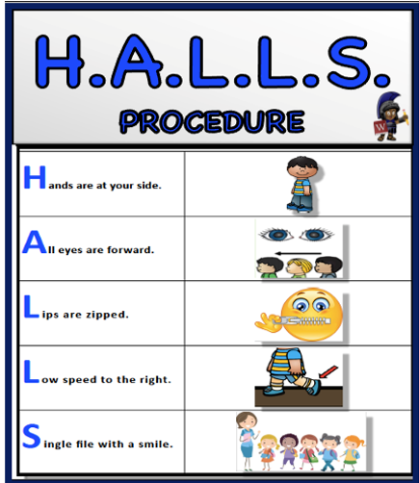
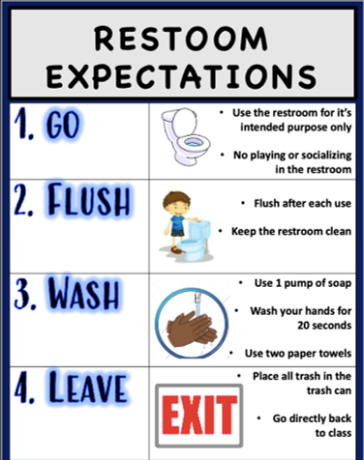
Behavioral Expectations
RESTROOM
EXPECTATIONS

Slide 5
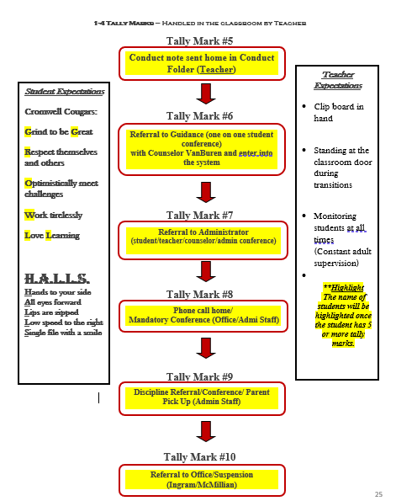
Behavioral Expectations

Slide 6
Title I
Every Student Succeeds Act (ESSA)
Family Engagement Plan
School/Student/Parent Compact
Student Progress Reports
Parents Right to Know
Parent/Teacher Conferences
Parent Training/Meetings
Parental Involvement Requirements
School Improvement Plan
Teacher Qualifications
Student Code of Conduct
District/School Progress Status
Notice of Title 1 School Status

Slide 7
Elementary and Secondary School Act (ESSA)
Title I, Part A of the Elementary and Secondary Education Act, as amended in Every Student Succeeds Act (ESSA), provided financial assistance to local educational agencies (LEAs) and schools with high numbers or high percentages of children from low-income families to help ensure that all children meet challenging State academic standards.
U.S. Department of Education

Slide 8
Family Engagement Plan & School/Home Compact
Purpose:
To partner with families in an effort to provide Cromwell Elementary students with a home, school, & community partnership that helps children achieve academic excellence.
Jointly developed with parents to promote positive and productive working relationships.
School/Student/Parent Compact.
SCS policy informing parents and students of expectations for a safe and orderly school environment, without disruptions to the learning process.

Slide 9
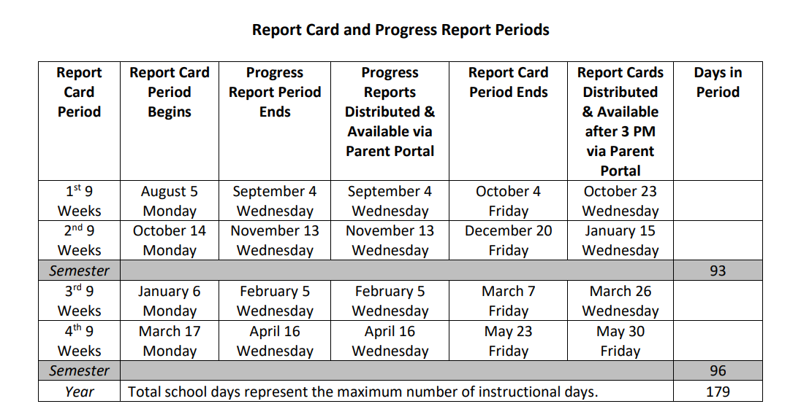
Student Progress Reports /Report Cards:

Slide 10
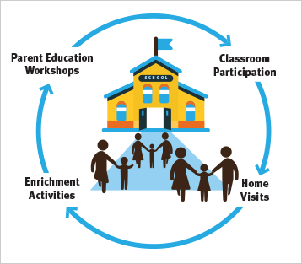
Parents’ Right to Know
Right to transfer to another school if a victim of a violent crime.
Right to be informed if child is being taught by a teacher 20 days or more who is not highly qualified.
All parents have the right to inquire about the following:
A teacher's professional qualifications
Type of degree or teaching experience
A paraprofessional's qualifications
Receive information on child’s achievement
level

Slide 11
Parent/Teacher Conferences:
September 5, 2024, from 4:00pm – 7:00pm
February 13, 2025, from 4:00pm – 7:00pm

Slide 12
School Events and Parent Meetings
Community Day
Doughnuts with Dads, Muffins with Moms
Family Literacy, Math & Science Curriculum Night
ESL Families Connect Meetings & Hispanic Heritage Day
Black History Month
Parent University Meetings
Data Days/Nights

Slide 13
How can parents get involved?
1. Actively participate in school activities.
2. Volunteer through our PTA to help with events throughout the year.
3. Parent-teacher conferences.
4. Attend Title I Meetings/Parent Meetings over the course of the year.
5. Attend Curriculum/Data Nights.
7. Encourage your child to read, study, do homework, pay attention and participate in class every day.

Slide 14
School Improvement Plan (SIP)
The school improvement plan is developed by stakeholders every year and will be posted on our website.
Analysis of data from District and State tests, school climate surveys, etc.
Development of an action plan in to address and meet the needs of our students, parents, and teachers.

Slide 15
STUDENT CODE OF CONDUCT
Attend school on a regular basis and be on time.
Complete all academic work (homework/classwork/projects) as assigned.
Bring appropriate materials to class.
Obey school/classroom rules.
Respect the rights of others.
Use appropriate language.
Respect school property.
Comply with requests of teachers/school staff.
Dress appropriate for school.

Slide 16
DISTRICT/SCHOOL PROGRESS STATUS
TITLE ONE STATUS
How are we doing?
We are a Level 2 School
We still need to work on growth and achievement; therefore, we need your help!

Slide 17
WE MAY NOT BE AN OPTIONAL SCHOOL; HOWEVER, OUR SCHOOL HAS MANY OPTIONS!
CHEERLEADERS and DANCE TEAM
Performances

