Slide 1
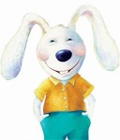
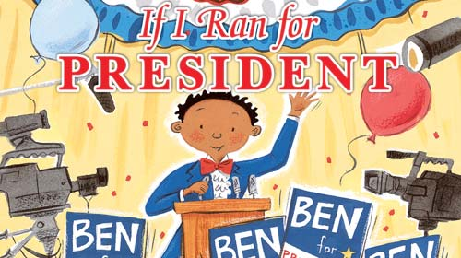
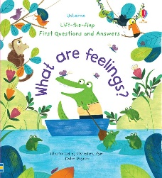
Staying Connected with
Counselor Hodges
March 30, 2020
Brewster Elem. 3/30/2020
Connecting with Children about COVID-19 https://www.livescience.com/coronavirus-kids-guide.html | Don’t have books at home..go Check out a book on Youtube! | Meet Howard B. Wigglebottom
We hope you enjoyed your extended break and be safe! ~~~~~~~~~~~~~~~~~~~~~~~~~ Suggested Home Activities Family Talent Show Paint ( rocks & tree limbs) Have a picnic in your house! Build a Fort Make up your own story and act it out Make a cool paper airplane Create a journal Have a bubble party Call family and friends Set Up a treasure hunt Write your family a letter Make a learning space Be creative! Play cards Put a puzzle together Set up an indoor Hopscotch |  | http://www.wedolisten.org/lessons. Listen better Listen to do your best Listen to do the right thing about bullying Listen to make the most of things & find the good side Listen to your body when angry or upset Listen and be truthful l Listen about being kind and sharing. Listen to food and screen watching rules Listen about belonging and special needs Listen to be a team player Listen about fear and courage Listen before trusting people Listen to why good manners are important Listen to get along better with others Listen to a friend who lost a pet or loved one

