Slide 1
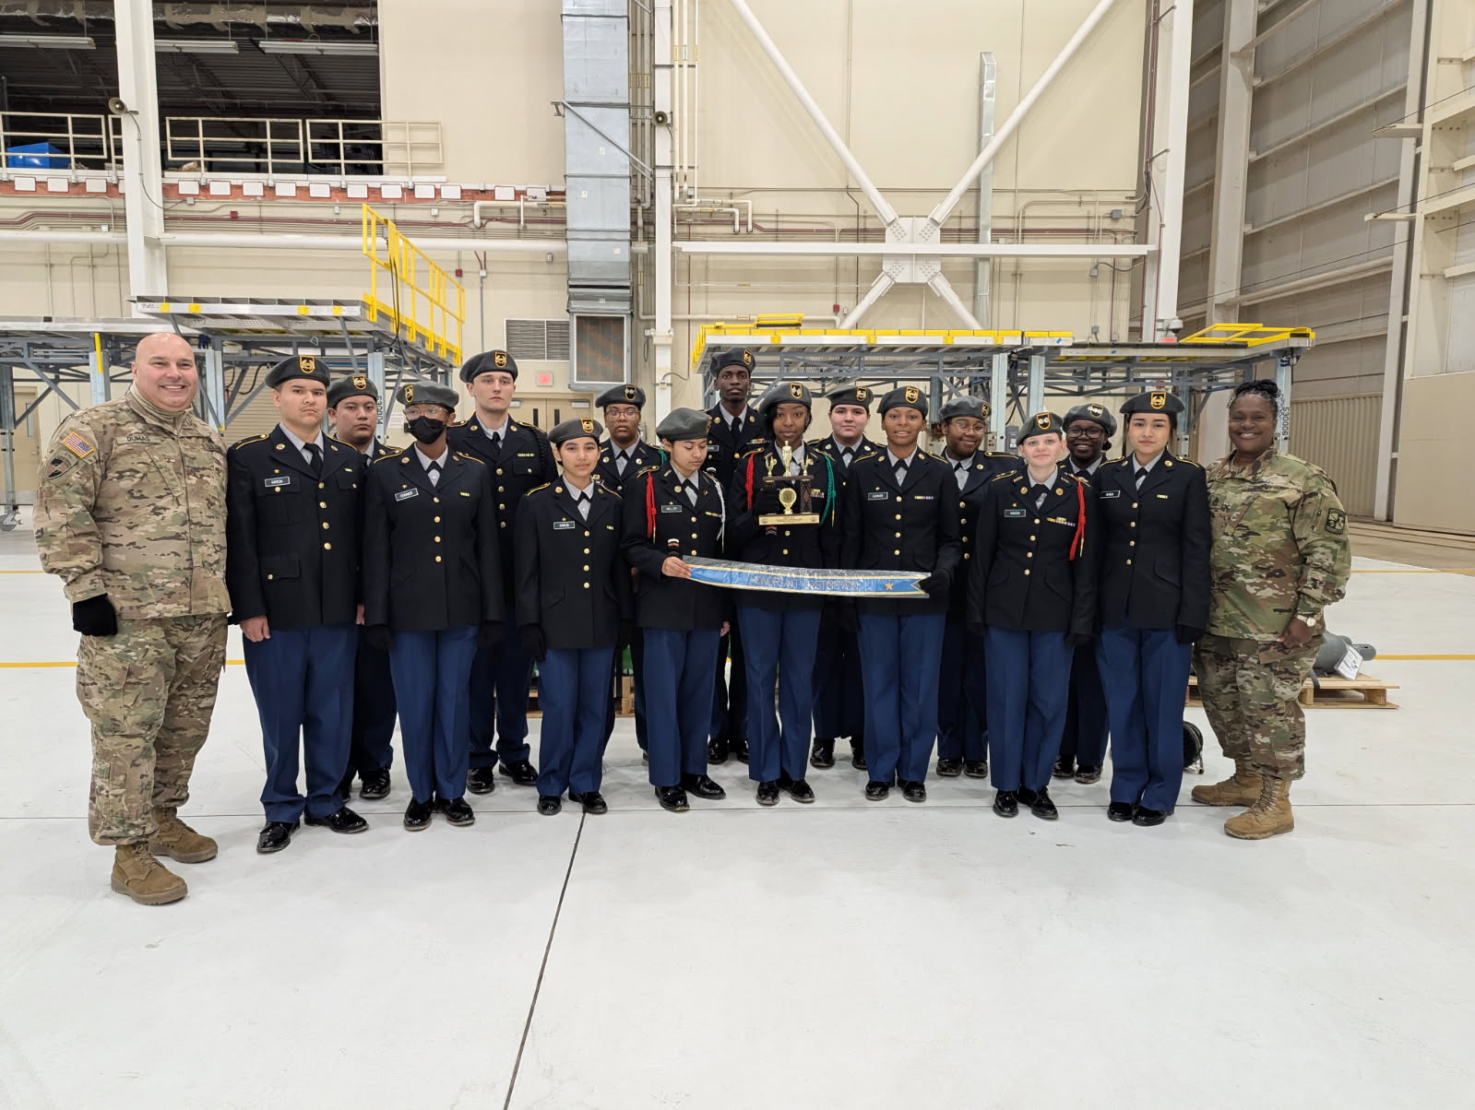
Kingsbury HS JROTC FEB-MAR 2025
Kingsbury High School Cadets Participated at the Annual MSCS JROTC Drill Team Competition
Our Falcon Battalion represented Kingsbury High School at the annual MSCS Drill Team Competition. C/MAJ Anna Brokamp said “This was a great opportunity to meet other Cadets in the County and measure our knowledge and skills against them”. “We placed at the Unarmed event, our hard work and sacrifice pay off” C/COL Erieuna Johnson. Kingsbury Cadets continues to represent Kingsbury in a positive way, solidifying their ranking in the county. Go Falcons!

