Slide 1
Screening for Characteristics of Dyslexia
Notes:
1 min.
Facilitator Note: So again, welcome to today's session, which is entitled Implementing the Blended Learning Station Rotation Model. I am your facilitator for today. My name is ______.
Do: Allow participants to sign-in if required by building admin. When it is time for the session to start, state the title and introduce yourself and allow moderator/co-presenter introduce themselves as well.

Slide 2
Click here to view video.
Complete attendance on next slide.
Notes:
Time: 30 seconds
Say: It is now time to participate in our District Roar. Please join me.
Do: Begin reciting the roar.
Lead the Roar!

Slide 3
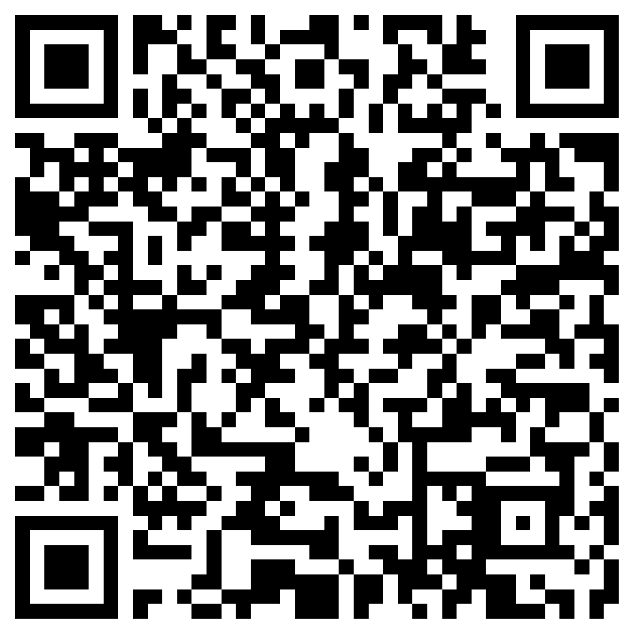
Attendance: Screening for Characteristics of Dyslexia
Click here or use the QR Code to submit attendance.
Notes:
Time: 30 seconds
Say: It is now time to participate in our District Roar. Please join me.
Do: Begin reciting the roar.
Lead the Roar!

