Slide 1
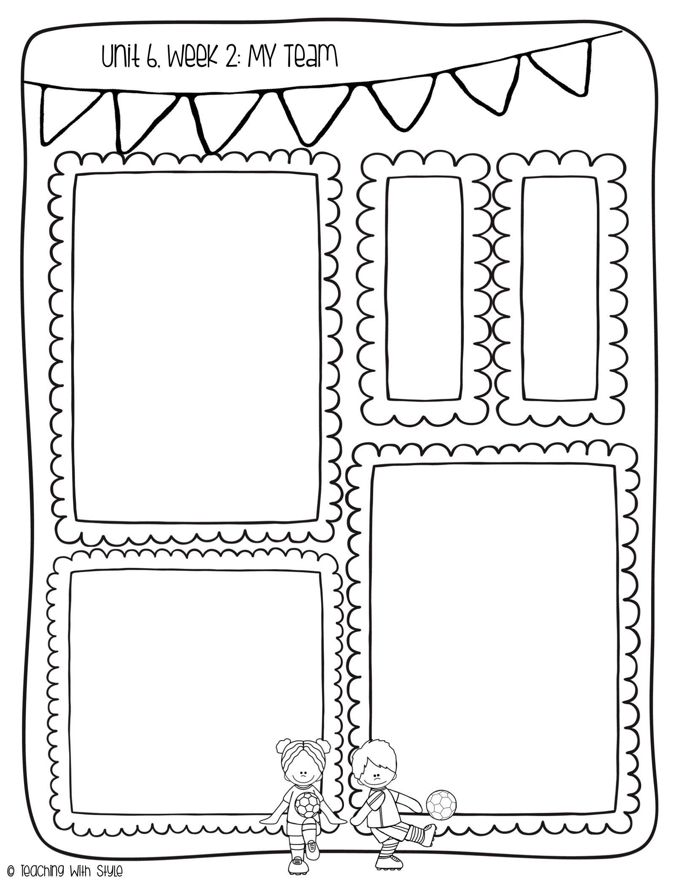
Week of 4/14
What we are learning!
Essential Question:
Who helps you?
Comprehension Focus:
Reread
Author’s Purpose
Word Work:
Variant Vowel ô
Vowel Team Syllables
Grammar:
Possessive Pronouns
Writing Trait:
Voice
Spelling Words
haul
cause
saw
claw
paw
dawn
moon
soup
love
friend
HF
Words
brother
father
friend
love
mother
picture
Math
We will finish learning about shapes this week.
We will test on Thursday. A study guide was sent home on Monday with homework.
Snack
Monday: Evie
Tuesday: Wells
Wednesday: Cora
Thursday: Camille
Reminders for the Week
-NO School on Friday
-Homework is due on Thursday this week.
-We need TCAP proctors (contact the office if you can volunteer)

